Slide 1
An Evolution of a Mindset: A Historical Perspective on Sandia National Laboratories Fire Science Philosophy
Stanford ICME Seminar Series
January 30th, 2020 Stanford University
Stefan Domino, Ph.D.
Computational Thermal & Fluid Mechanics
Sandia National Laboratories SAND2019-15457 PE

Slide 2
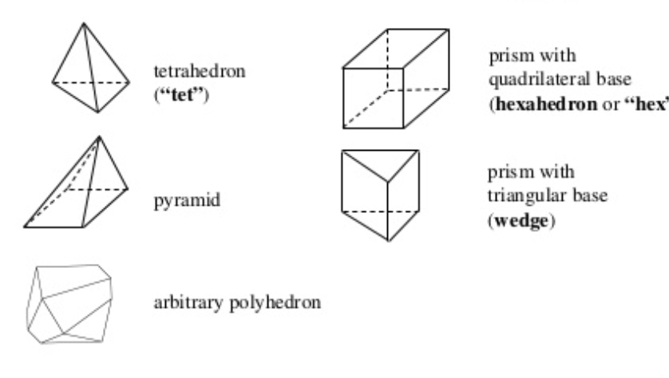
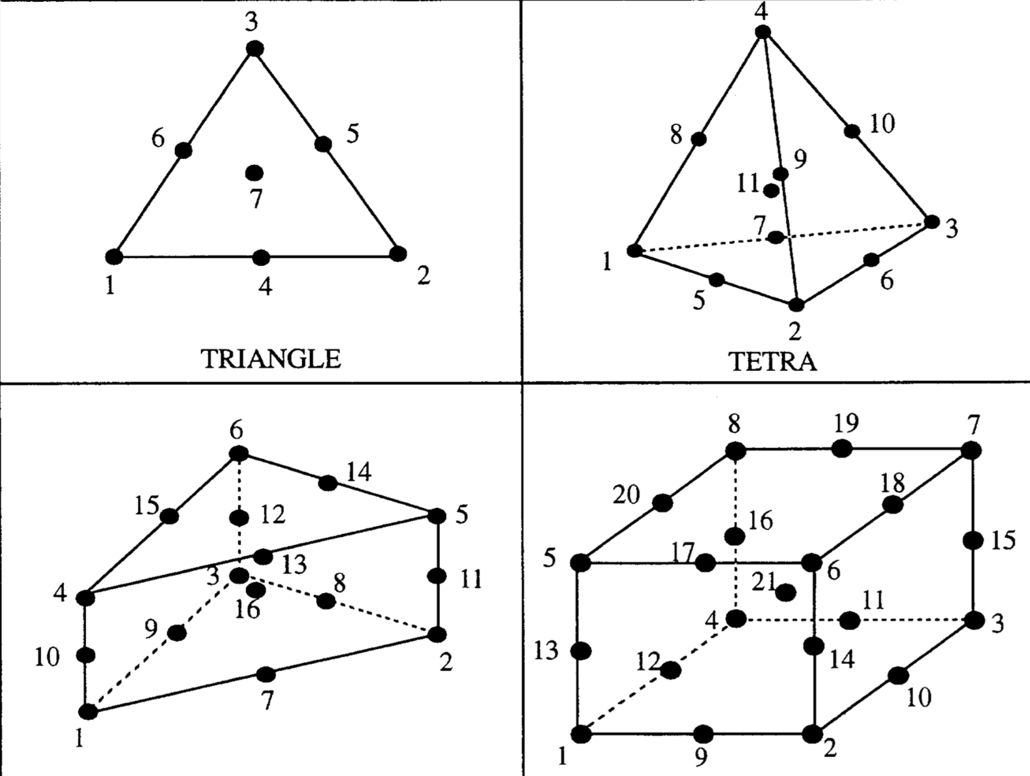
Examples of Various Supported Topologies
Hex8
Tet4
Pyramid5
Wedge6
Higher-order promoted elements (Hex27, Tet10)

Slide 3
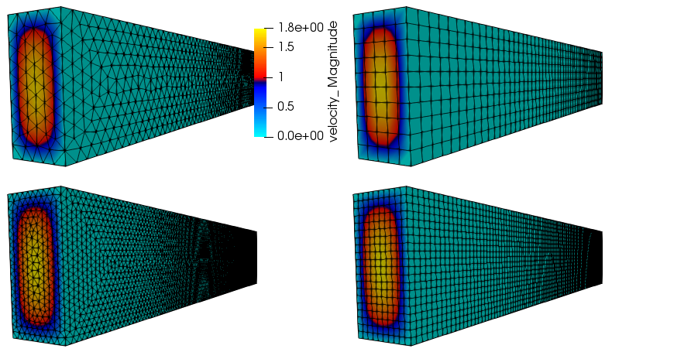
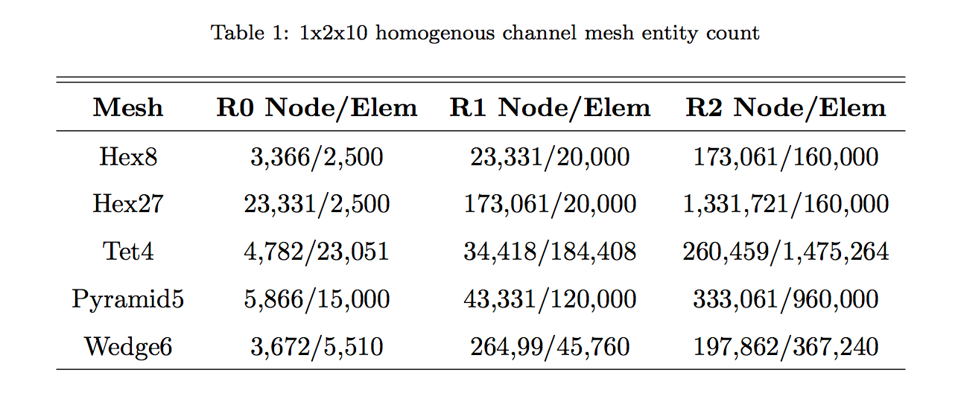
What About Numerical Quality?
Domino et al., Comp. & Fluids, 2019 1x2x10 Findings:
All topos (Hex8, Hex27, Tet4, Wedge6, Pyramid5) provide design-order accuracy
Hex8 and Wedge6 provide the same accuracy
Tet4 results in ~3.5x higher error and matches pyramids
Higher-order (P=2) notes ~an order of magnitude lower error for the first mesh refinement level (promoted Hex8 R0 mesh)
Tet4/Pyramid5 O(5)x slower than Hex8/Wedge6 to meet the same accuracy (resource limited model)
NEW: Tet10 R0 comparable with Hex8 R1
Hybrid (Hex8, Tet4, Wedge6, and Pyr5) also design-order (see the paper for plots)

Slide 4
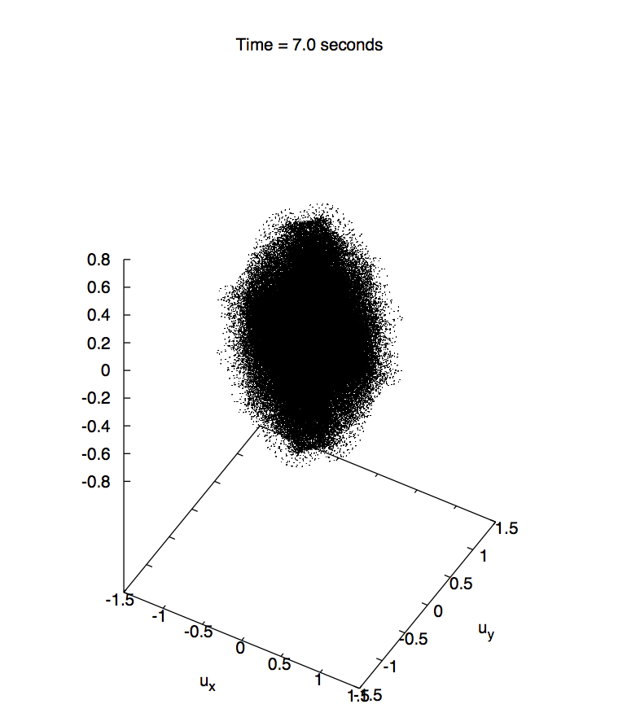
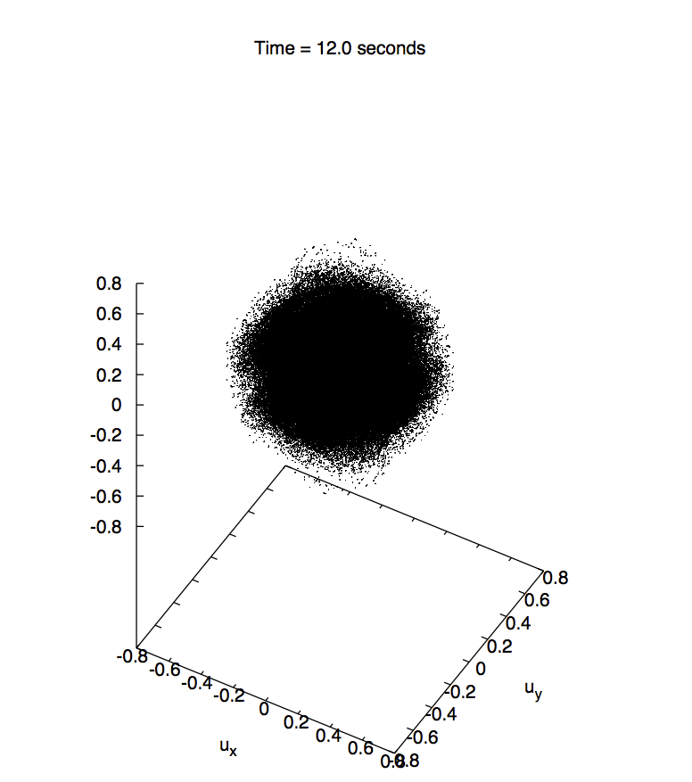
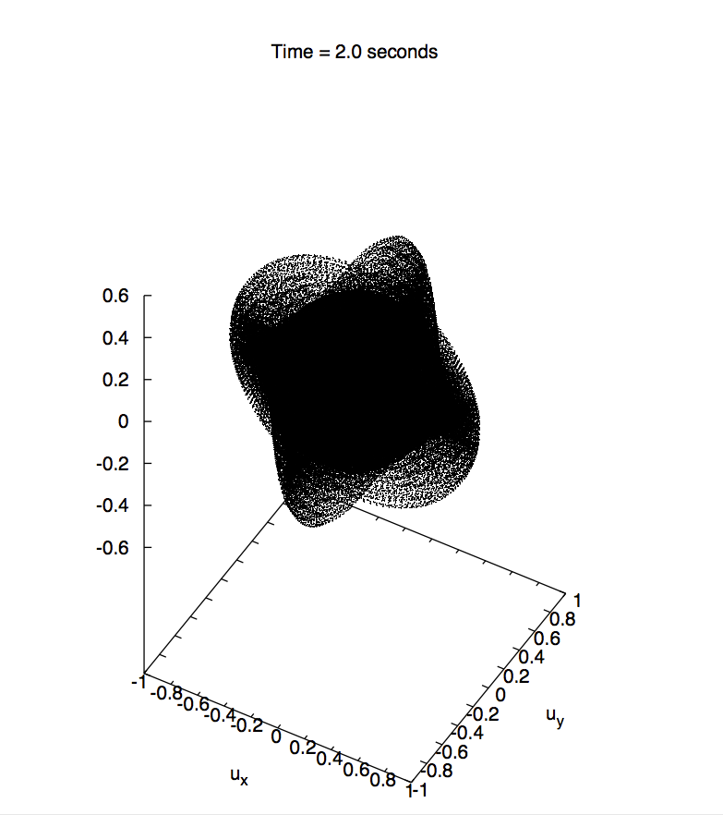
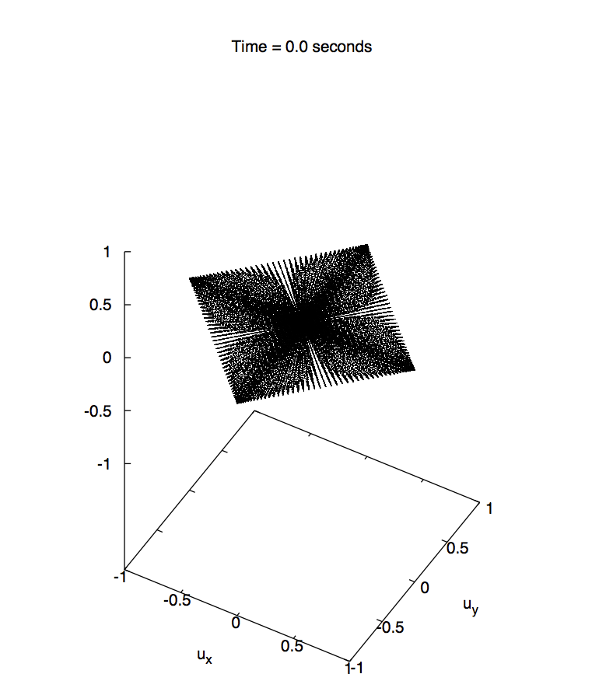
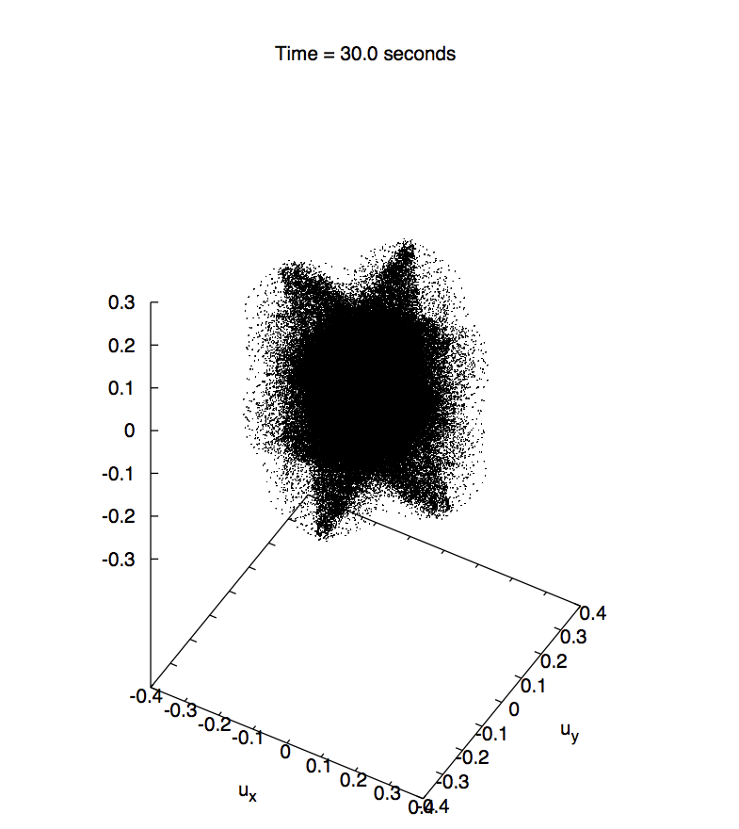
Taylor-Green Vortex (Re 1600)
Well studied problem that is part of the following numerical benchmark:
“C3.5 DNS of the T/G Vortex at Re = 1600”
QoI: turbulent kinetic energy vs time and dissipation rate vs time
First phase: small viscous effects, small-scale structures are laminar and organized [easy]
Second phase: viscous (diffusion) dominates, structures are distorted [harder]
Break-up phase: flow is dissipating fully [easy – assuming initial response is accurate)]
German Aerospace Center

Slide 5
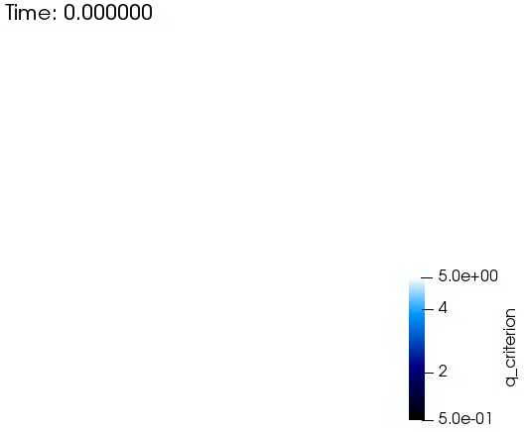
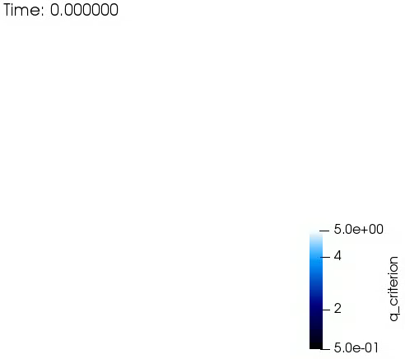
Taylor-Green Vortex (Re 1600)
Visual Comparison
Hex64
Hex8
Tet4
Wedge6

Slide 6
Taylor-Green Vortex (Re 1600) - Results
All topos converge to baseline DNS
Pyramid5/Wedge6 (at R1) looks very good
Cost vs Accuracy: P=2 wins

Slide 7
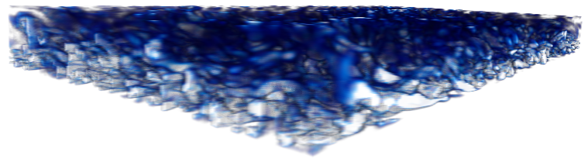
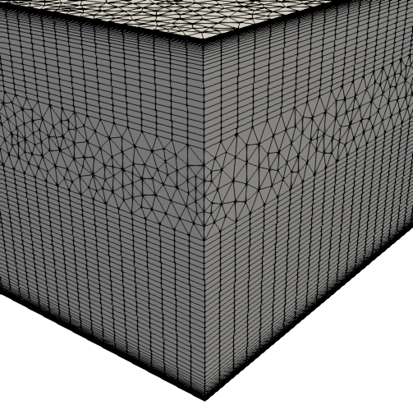
Plain Channel Flow (Re^{τ} 180)
Hybrid mesh study based on Ham and Iaccarino, CTR Annual Brief, 2006, found that simulations were extremely sensitive to mesh topology
Non-symmetric time mean flow found for cell-centered; better for the CTR node-centered formulation
Native CVFEM and EBVC are both symmetric in mean quantities
T
B

Slide 8

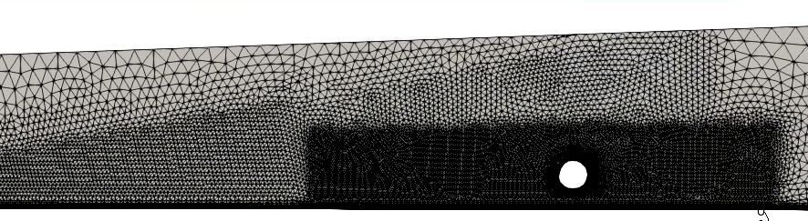
Flow Past Heated Water Channel
WRLES Ksgs model demonstrates decent mesh convergence (Domino et al. Comp. & Fluids, 2019)
θ = 0 and 180º is hard to converge due to thermal boundary layer development (θ = 0) and complex recirculation (θ = 180)
Tet4 simulations are also predicting the flow well at a reduced time
Tet10 (not showcased in the paper) is also very promising

